Slide 1
2 – Types of Data and Variables

Slide 3
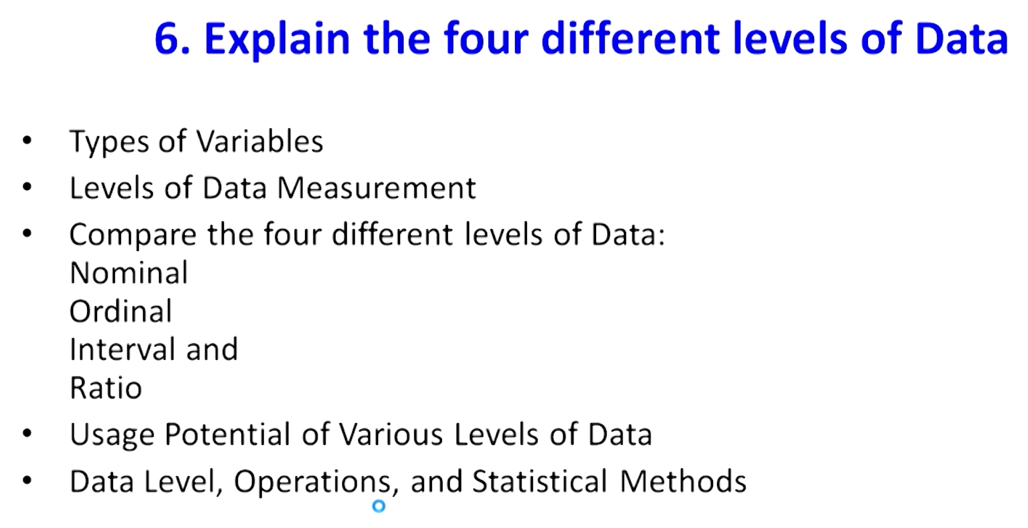

Slide 4
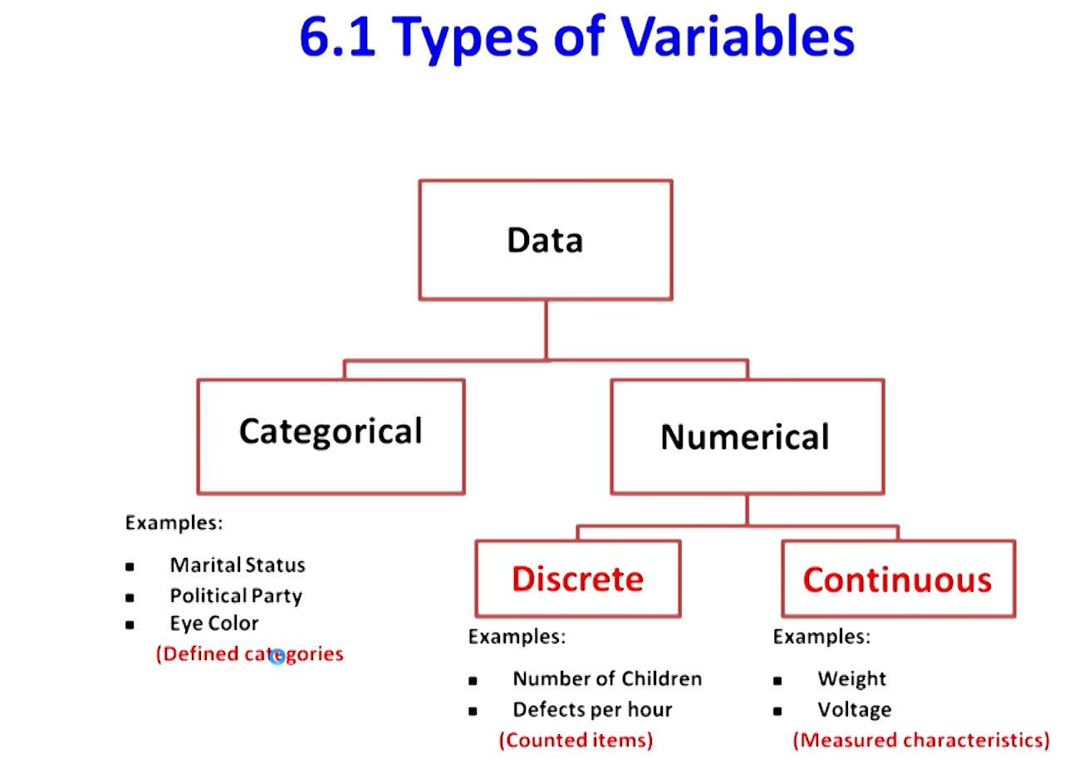

Slide 5
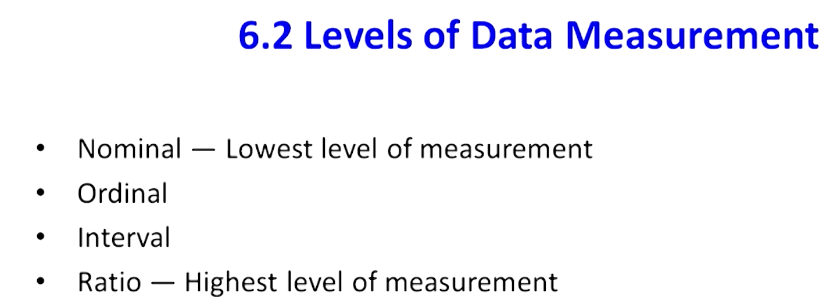

Slide 6
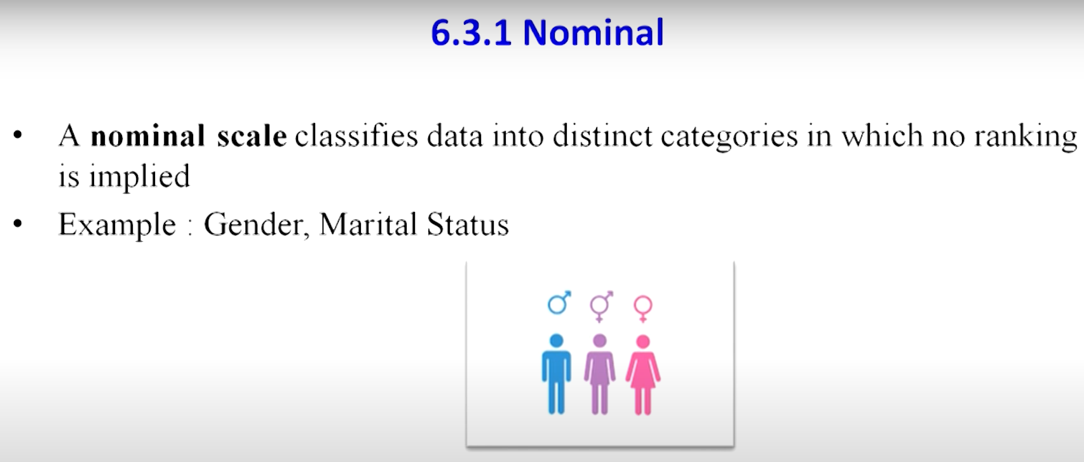

Slide 7
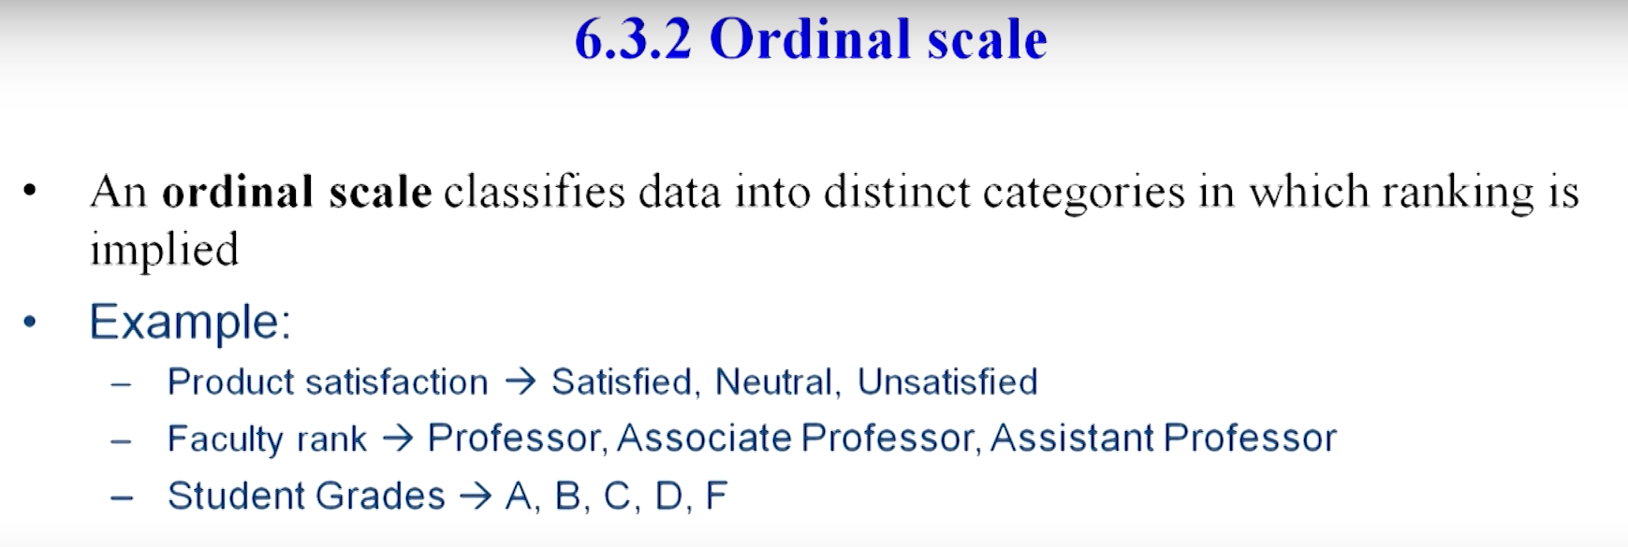

Slide 8
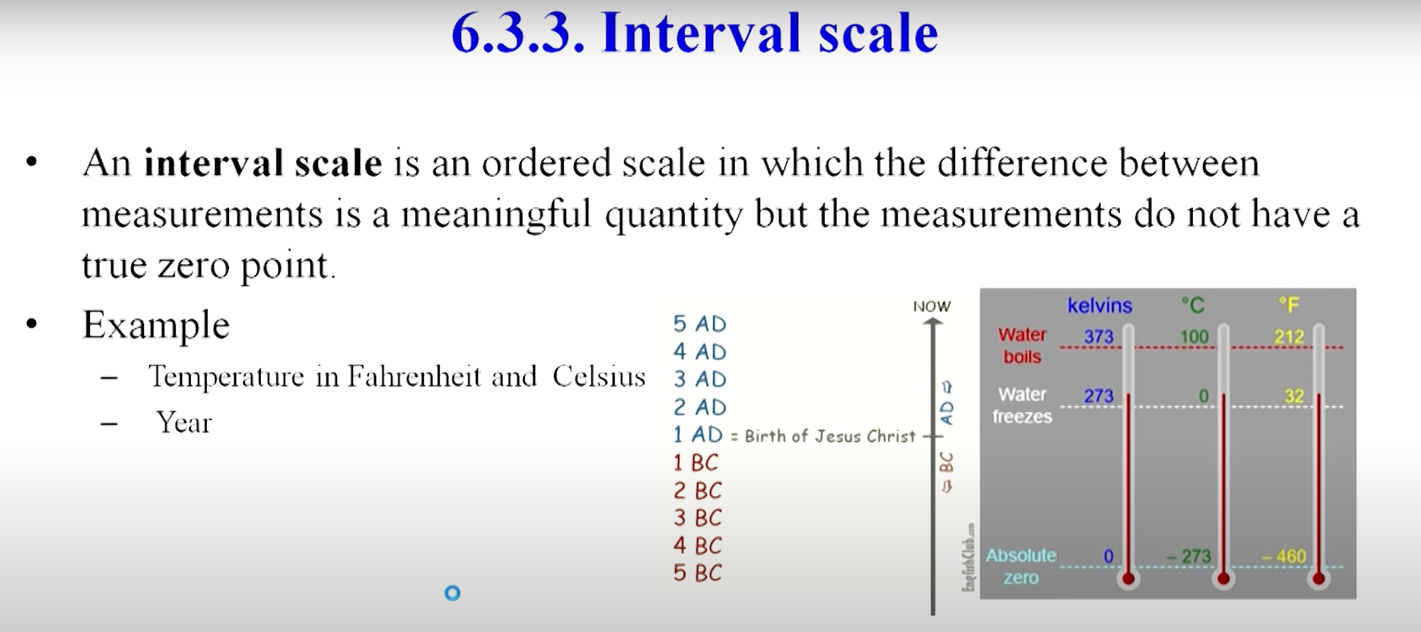

Slide 9
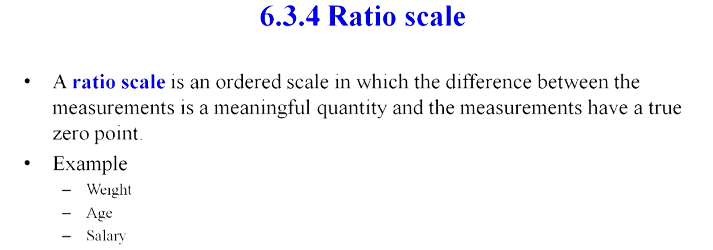

Slide 10
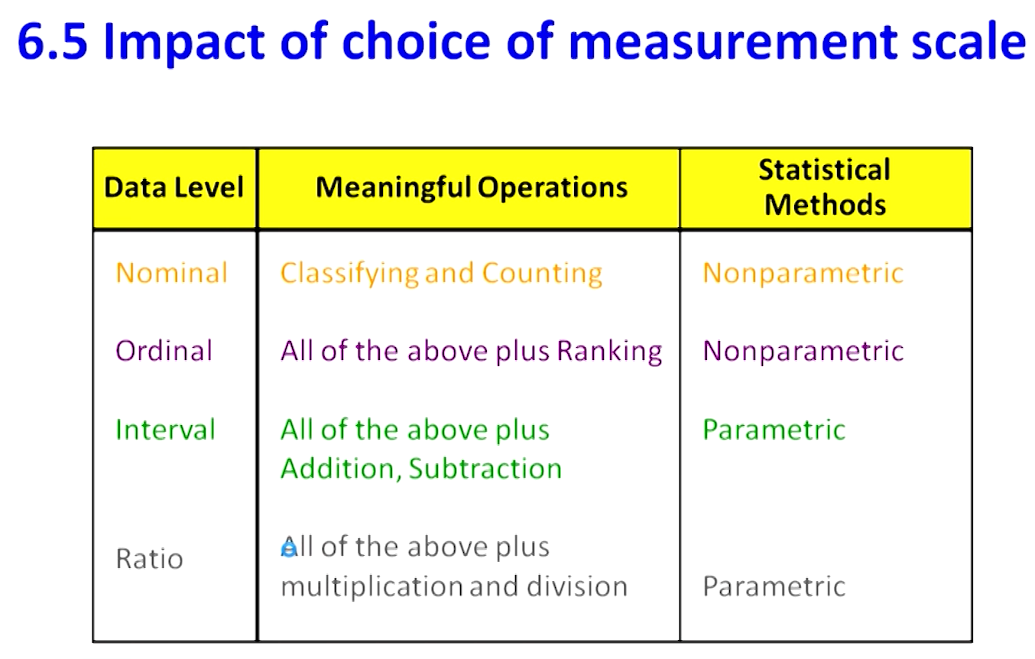
Parametric tests are those that make assumptions about the parameters of the population distribution from which the sample is drawn. This is often the assumption that the population data are normally distributed. Non-parametric tests are “distribution-free” and, as such, can be used for non-Normal variables.

